Slide 1
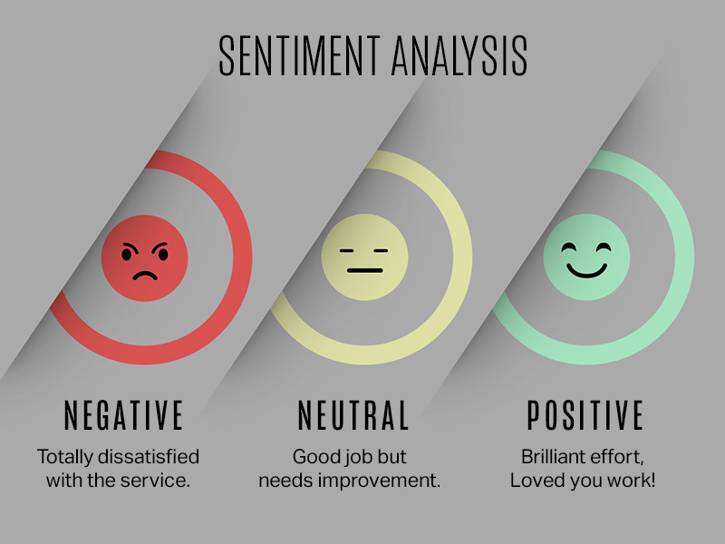

AI Sentiment Utility
Gen Ai &Machine Learning : Social Media Insight

Slide 2
Problem Statement:
Social media platforms host a vast array of opinions and sentiments, making sentiment analysis a critical task for various stakeholders.
However, effectively analyzing sentiment across different domains like politics, product feedback, and brand perception is challenging due to the volume and diversity of social media data.
Imagine a utility powered by AI and General AI (GenAI) that can conduct sentiment analysis on social media data comprehensively and flexibly.

Slide 3
Statistics:
At the core of sentiment analysis’ promising future lies the potency of AI. Machine Learning (ML) and Deep Learning have elevated sentiment analysis models, enabling them to grasp context, idiomatic expressions, and even cultural nuances.
Sentiment analysis helps businesses identify common pain points and issues faced by customers.
Source link: https://www.zonkafeedback.com/blog/sentiment-analysiscustomerfeedback
Source link: https://aventior.com/blogs/the-future-of-sentiment-analysis-unveiling-advances/

Slide 4
Stakeholders:
Technology Companies
E-commerce Platforms
Marketing Agencies
consumers

Slide 5
Present Scenario:
Language and Context Understanding
Scalability and Performance
Bias and Subjectivity
Integration with Existing Systems

Slide 6
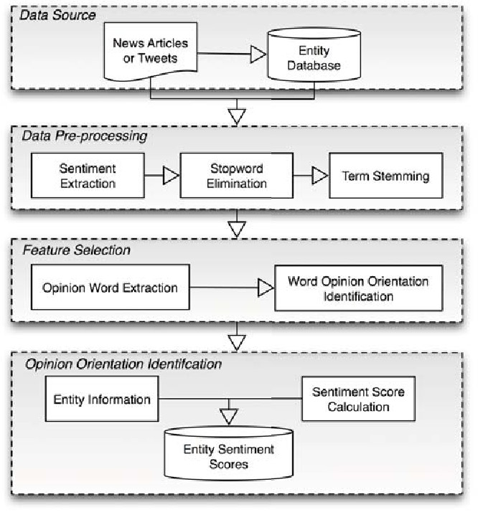
Proposed Solution - Predictive/ Preventive Maintainance

Slide 7
Features:
Accurate classification of customer feedback into positive, negative, or neutral sentiments, Visualization of sentiment trends over time, allowing stakeholders to track changes in customer sentiment
Integration with feedback loop mechanisms to close the loop on customer feedback Ability to collect customer feedback data from various social media platforms, including Twitter, Facebook, Instagram, and review sites
Comprehensive training and support services to help users understand and maximize the value of sentiment analysis for improving customer experience

Slide 8
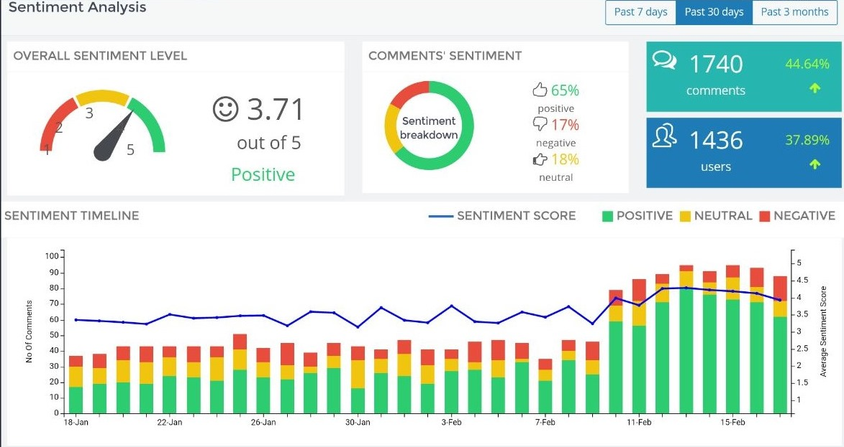
D A S H B O A R D R E P O R T S

